Slide 1
Alignment of Cell Culture Modeling
Problem: Duplicated and inconsistent representations of cultured cells and cell cultures/lines in OBI, CLO, CL, ERO, and ReO
Goals: Align representations, define important concepts, and define a single class per concept that can be re-used across ontologies
Process: Several alignment calls, email correspondence, and offline work
Status: consensus modeling implemented in OBI. Certain classes will be relocated elsewhere. A few open issues remain.

Slide 2
Challenges
Accommodate CLO switch to representing cell lines as single cell line cells
Fundamental disagreements on core domain concepts (e.g. the nature of cell lines)
Disagreement on how to use common but ambiguous domain terms such as ‘primary' and ‘line’
Integration of inconsistent legacy modeling in OBI into new/aligned approach
Where will classes live - deciding on homes for URIs

Slide 3
Conceptualizing of the Domain
Classification needed along two different axes:
Processing-Based Axis: what types of cultures emerge as cells are processed, propagated, and modified. . .
primary cell cultures -> cell lines -> immortal cell lines
. . . and what are the precise distinctions between them
Scale-Based Axis: what extents of collections of cultured cells are valuable/important to represent
single cultured cells
the entire population/lineage of cells derived from an initial establishment of a culture or line
working portions of a given culture or line applied in research

Slide 4
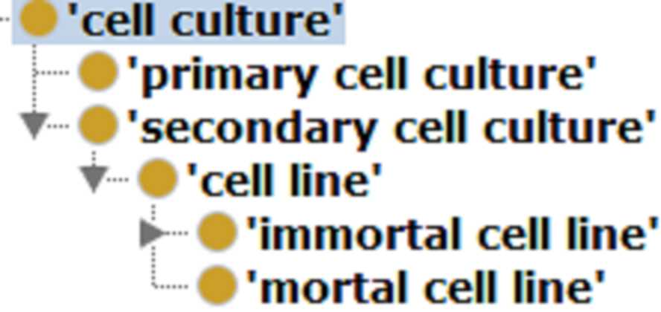
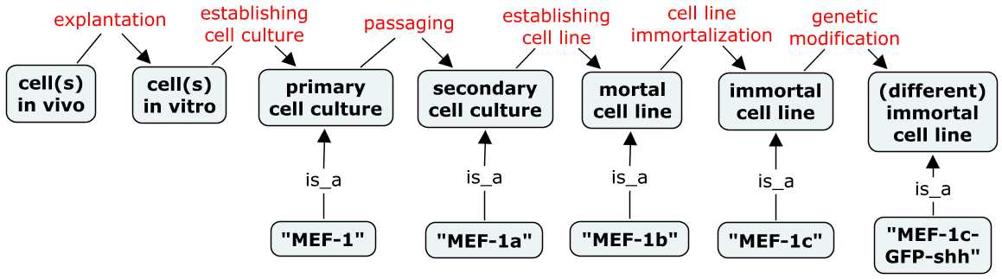
Processing-Based Axis of Classification
Specific experimental modifications lead to establishment of new types of cultures

Slide 5
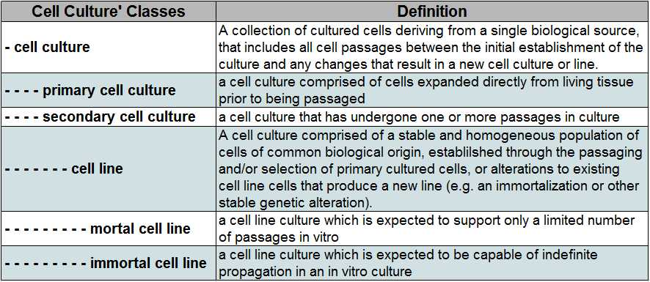
Processing-Based Class Definitions
https://docs.google.com/spreadsheet/ccc?key=0AiKzIoedGeqJdEkwd2Q1aFJPTHR5d0U5VUpkekJ3b1E#gid=5
Notes:
. . . so the HeLa cell line includes all HeLa cells in all labs across the world. So the concept of a cell culture or line is not particularly useful for annotating data, as these are not the material actually applied in experiments. This was one motivation for CLO switching to representation of individual cell line cells, and prompted work to define ‘cell line sample’ classes that represent the portions of cell lines that are actually sold, applied, and referenced in the practice of research.

Slide 6
Processing-Based Class Definitions
Key Features:
Primary cultures are freshly isolated,
heterogeneous, and not yet passaged
2. Secondary cultures have been passaged one or more times
Passaging is a biologically significant event – a selective process that leads to more uniform cell type composition and promotes adaptive biochemical changes required for continue survival
3. Cell lines have been passaged/selected to some degree of genetic stability and compositional homogeneity
4. Modifications of existing lines can establish new ones (immortalization, stable genetic modifications, etc)
5. There is only a single instance of a given type of culture or line a culture (e.g. ‘HeLa cell line’), comprised of all cells derived from the initial establishment of the culture up until a point where additional changes establish a new cell culture/line

Slide 7
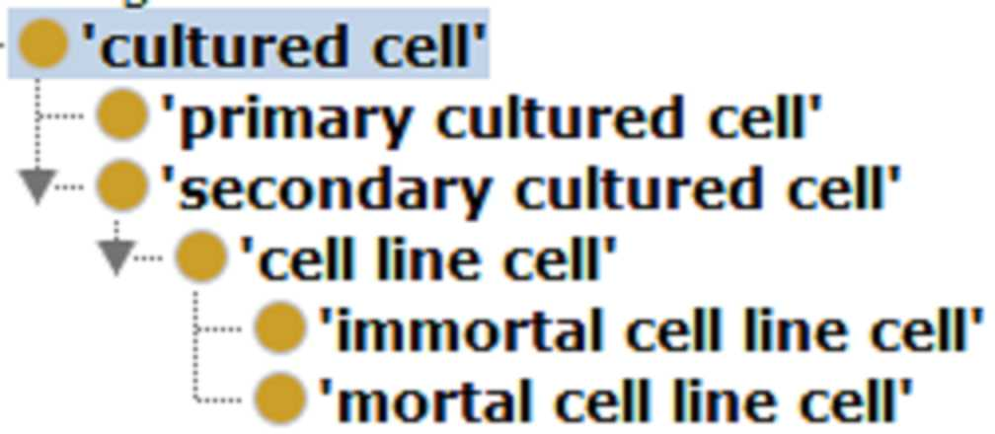
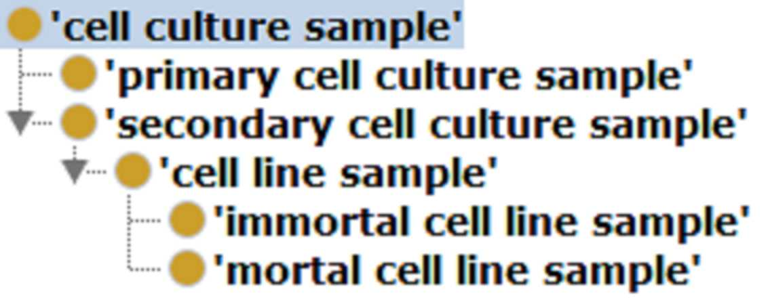
Scale-Based Axis of Classification
Three hierarchies that represent different sized ‘populations’ of cultured cells relevant in different experimental contexts
A single cultured cell
A cell culture or cell line as an entire ‘lineage’ of cells
A cell culture sample as an applied portion of a cell culture/line
Results in some hierarchy duplication, but I feel that to some extent this is warranted. . .

Slide 8
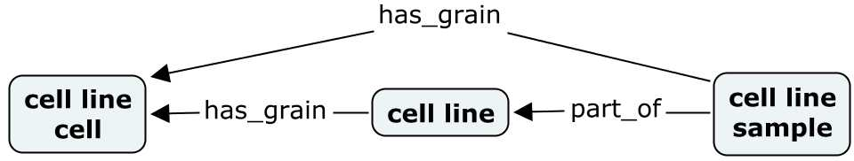
Cell Culture/Line Samples
Cell line samples are collections of cultured cells comprised of a defined portion of a cell line that has been successively passaged together, is output from a single cell culture splitting process, and is treated as representative of the single line of which it is a part.
Definitional criteria clearly demarcate a useful collection of cells as a ‘sample’, which represents what researchers actually culture, experiment on, and share.
Will be a relatively uniform population (similar evolution/genetic drifts due to continuous co-culture)
All cells necessarily output from a single subculture or storage split, and thus necessarily have the same passage number

Slide 9
Review Consensus Model in OBI
Encountered resistance to duplicated parallel modeling
(specifically, the need for the cell culture branch).
PROS:
Cell cultures/lines are the fundamental concept here – cultured cells and samples are dependent on these entities as their parts. Explicit modeling of cultures can be referenced to anchor understanding of cultured cells and samples.
There are times when we want to talk about cultured cells at each of these levels, as there are characteristics and processes relevant to each.
gene expression (cells)
morphology (cells)
biological derivation (cells)
growth characteristics (cells or cultures)
genotype or STR profile (cells or cultures)
establishment of a culture/line (cultures)
experimental inputs (cells or samples)
catalog descriptions (cultures or samples)
catalog offerings (samples)
cell line contamination (samples)
passage number (samples)

Slide 10
Review Consensus Model in OBI
Encountered resistance to duplicated parallel modeling (specifically, the need for the cell culture branch). But I feel it is warranted.
CONS:
Duplication of effort and maintenance of consistency
but hierarchies are small and not likely to expand or change
Confusion as to when to apply each to data
documentation will make this clear

Slide 11

Culture Related Processes
Minimal culture-related process modeling in CLO, but want OBI to take ownership and CLO will import from OBI
1. Establishing cell culture branch refined to disambiguate and split apart unclear and conflated OBI classes
Split into more precise subtypes, to describe the many ways that different culture types can be created.
Key for identifying the extent of a culture and when new cultures come into being and how lines/cultures are related to each other.
2. Maintaining cell culture branch – will implement more granular subtypes here for CLO. Work in progress.

Slide 12
Refactoring of Existing OBI Classes
into New Model
Distinction between cell lines and cell line samples not made in previous OBI modeling
Existing classes relabeled and defined to be cell culture samples
cell culture -> cell culture sample
primary cell culture -> primary cell culture sample
cell line culture - > cell line sample
Various IEDB classes such as 'CD4- T cell culture‘ also asserted as samples (grouped as 'immune cell culture classes')
A handful of specific lines such as '293T cell culture’ also asserted as samples

Slide 13
Next Steps
Interested OBI developers review/vet modeling, and weigh in on unresolved issues
Finish/refine process modeling, improve documentation and axioms on classes
Distribution and MIREOT of classes to/from their proper home ontologies

